Slide 1
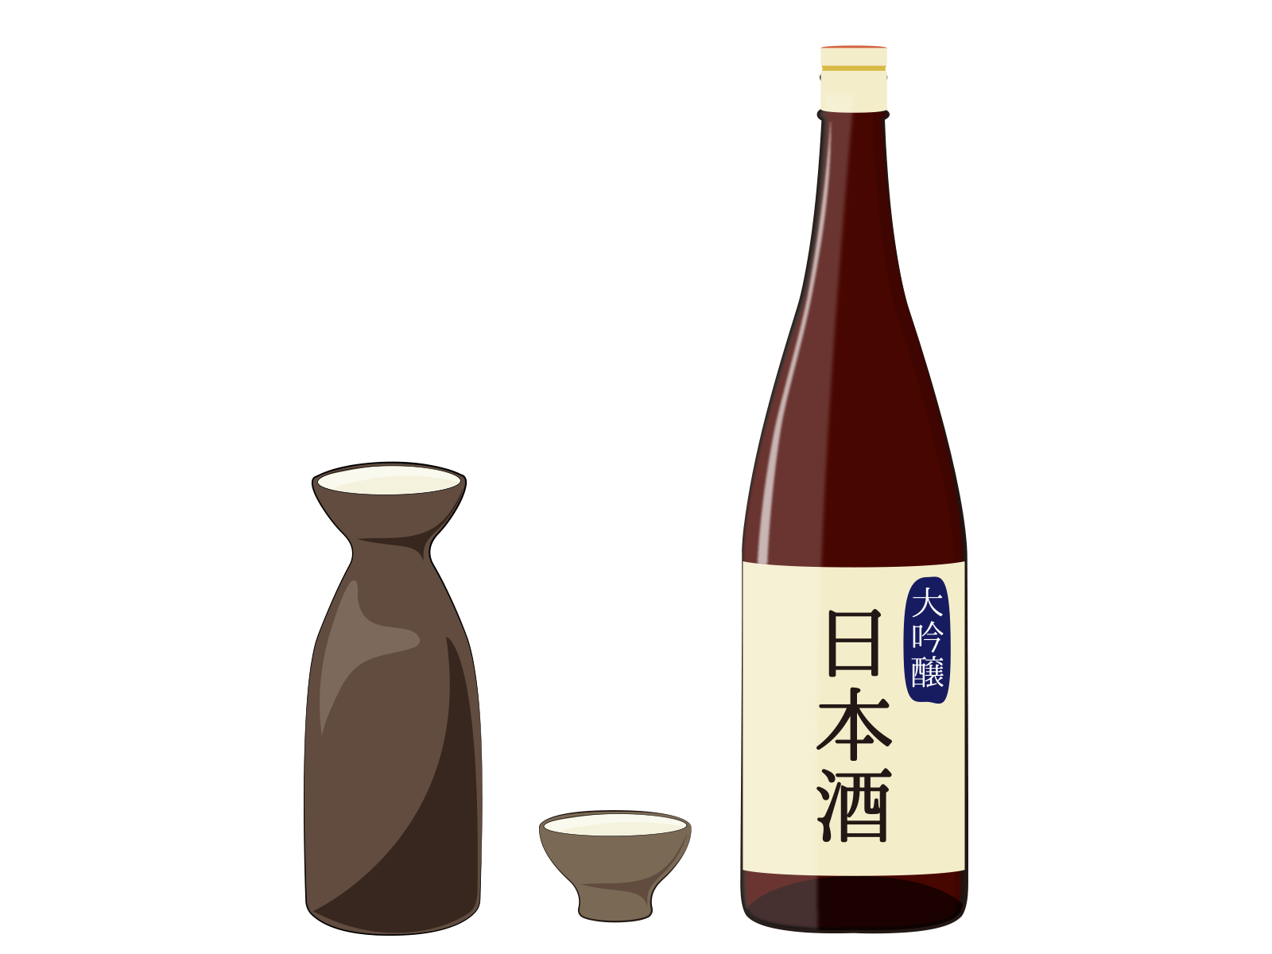
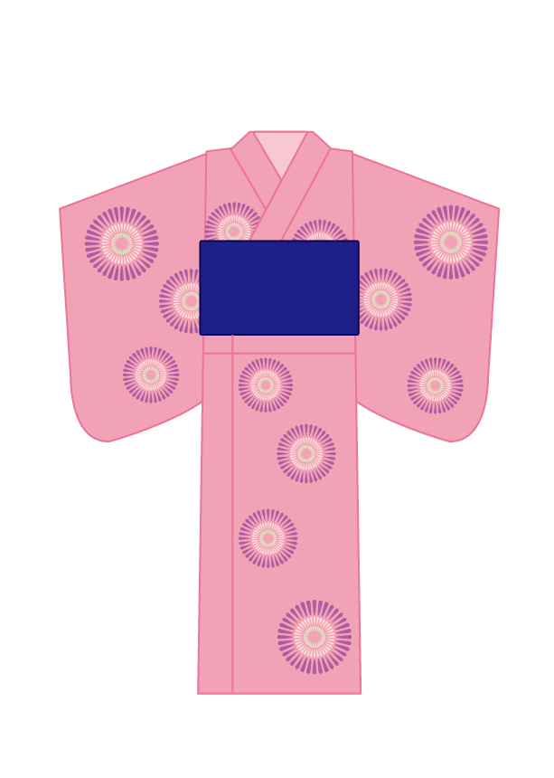

Floor Map
Welcome to Hotel Kamogawasou. We are delighted to have you with us.
Seif laundry
Free Wi-Fi
SSID Password | ： kamogawa ： kamo8080
① Your room is （ ） on the（ ）th floor.
お客様のお部屋は（ ）階（ ）号室です
② The guest rooms have self locking doors.
お部屋はオートロックです
③ Your dinner will be served at SHIKITEI on the 2nd floor.
Breakfast is served buffet-style in the HEISEI on the 3rd floor.
Breakfast is served from 7:00 AM to 9:00 AM.
夕食は２階の四季亭・朝食はブッフェ形式で３階の平成でご用意いたします。
朝食の時間は7時～9時です
④ The public bath is located at the end of the hallway on the 1st floor.
大浴場は１階のつきあたりです
The public bath is open from 3:00 PM to midnight, and from 6:00
AM to 9:00 AM in the morning.
大浴場は15時～24時 朝は6時～9時です
⑤ Towels are provided in your room.
Please bring them with you when you go to the public bath.
タオルはお部屋にございます。大浴場へ行く際にお持ちください
⑥ Amenities are not provided in the guest room.
Please feel free to pick them up from the lobby if needed.”
アメニティはお部屋にございません。必要でしたらロビーからお持ちください
⑦ The hotel’s original yukata has been placed in your room.
Colorful yukata are available in the lobby.”
オリジナル浴衣がお部屋に、色浴衣はロビーにございます
⓼ The coffee machine is available 24 hours a day, free of charge.
コーヒーマシンは24時間無料です
⑨ Please enjoy a free tasting of Hiroshima’s local sake, available until 9:00 PM.
日本酒飲み比べは21時まで無料です
Check out is 10am.
チェックアウトは10時です
Should you require any assistance, please feel free to visit the front desk.
何かご用がございましたらフロントへお越しください
Vending machine
Main building
EV
Emergency
stairs
③
平成
East building
EV
Breakfast room
“HEISEI”
四季亭
West building
EV
Restaurant “SHIKITEI”
③
Corridor
H
O
T
A
R
U
①
H
O
T
A
R
U
②
A
Y
A
M
E
①
Souvenir Shop
AM 7 ~ PM 9
Table
tennis
A
Y
A
M
E
②
Main building
EV
Hotel Entrance
④
Open-air bathes
⑧
Smoking booth
Sauna
Lobby
⑨
YUZUKI
⑥⑦
West building
EV
Hot spring
Garden
Entrance
We have the bathing tax policy. It is required by the law in Japan.
The cost is 150 yen per person per night.
You have to pay the tax when you are our guest, even if you don’t use any bath facilities.
We thank you for your support and understanding. Thank you.
日本には法律で義務付けられている入湯税という制度があります。
お一人当たり１泊150円でお風呂の施設を使わない場合でも、お支払いいただいております。
ご理解いただけますと幸いです。
IRORI
HISYOU
⑤
Private bath
Emergency stairs
The vending machines on each floor

